Slide 1
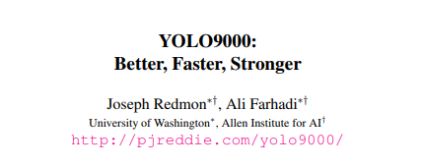
CVPR2017
鄭宇翔

Slide 2
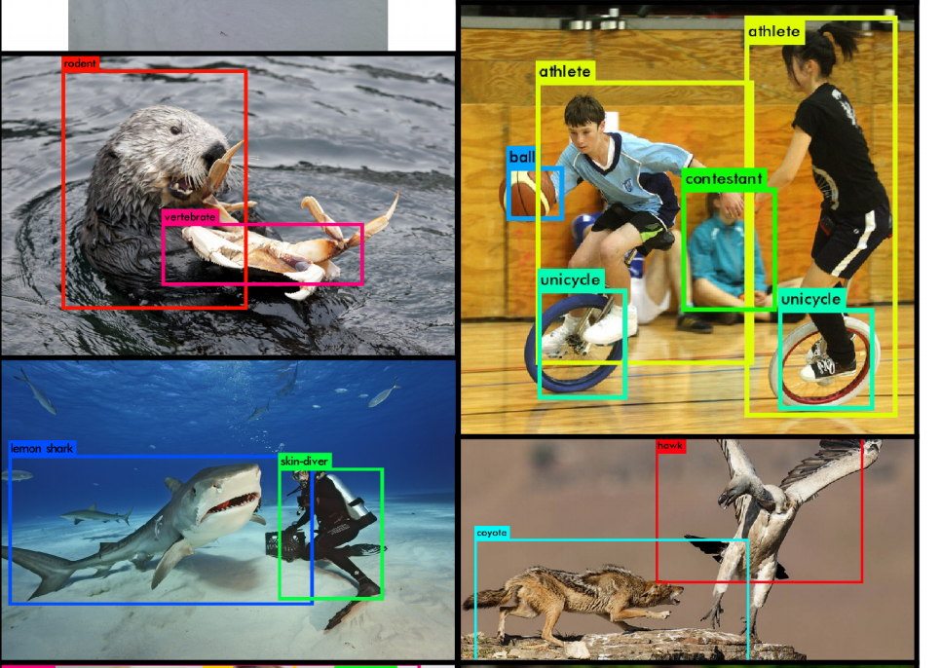

Slide 3
Abstract
propose various improvements to the YOLO detection method, both novel and drawn from prior work
multi-scale training method the same YOLOv2 model can run at varying sizes, offering an easy tradeoff between speed and accuracy
outperforming state-of-the-art methods like Faster RCNN with ResNet and SSD while still running significantly faster

Slide 4
Abstract
Joinly train on object detection and classfication
Train YOLO9000 simultaneously on the COCO detection dataset and the ImageNet classification dataset. Our joint training allows YOLO9000 to predict detections for object classes that don’t have labelled detection data.

Slide 5
Introduction
General purpose object detection should be fast, accurate, and able to recognize a wide variety of objects
most detection methods are still constrained to a small set of objects.
object detection datasets are limited compared to datasets for other tasks like classification and tagging.
labelling images for detection is far more expensive than labelling for classification or tagging
Notes:
General purpose object detection should be fast, accurate, and able to recognize a wide variety of objects
Since NN have becom increasingly fast and ac

Slide 6
Introduction
propose a joint training algorithm that allows us to train object detectors on both detection and classification data.
Our method leverages labeled detection images to learn to precisely localize objects while it uses classification images to increase its vocabulary and robustness.

Slide 7
Better
Error analysis of YOLO compared to Fast R-CNN shows that YOLO makes a significant number of localization errors. Furthermore, YOLO has relatively low recall compared to region proposal-based methods
focus mainly on improving recall and localization while maintaining classification accuracy
We pool a variety of ideas from past work with our own novel concepts to improve YOLO’s performance

Slide 8
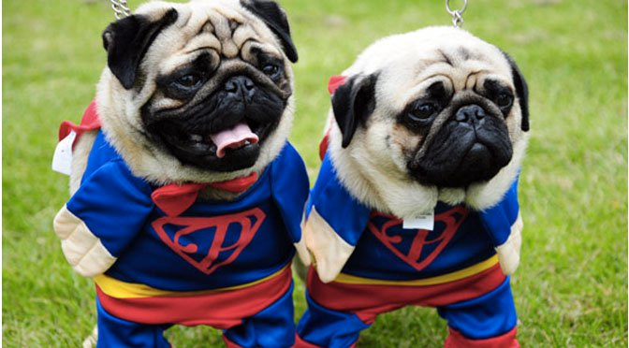
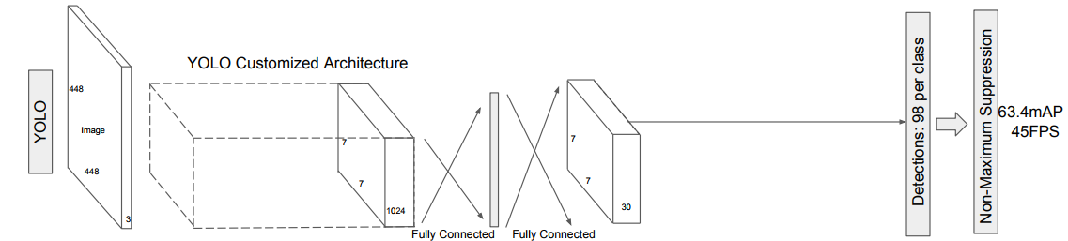
yolo
point x,y bbox w,h
Confidence
=5
Convs
class (20)
flatten
Per grid
= 2
3x3x30
Maxclass ‘car’
*
loc
softmax
BoxReg

Slide 9
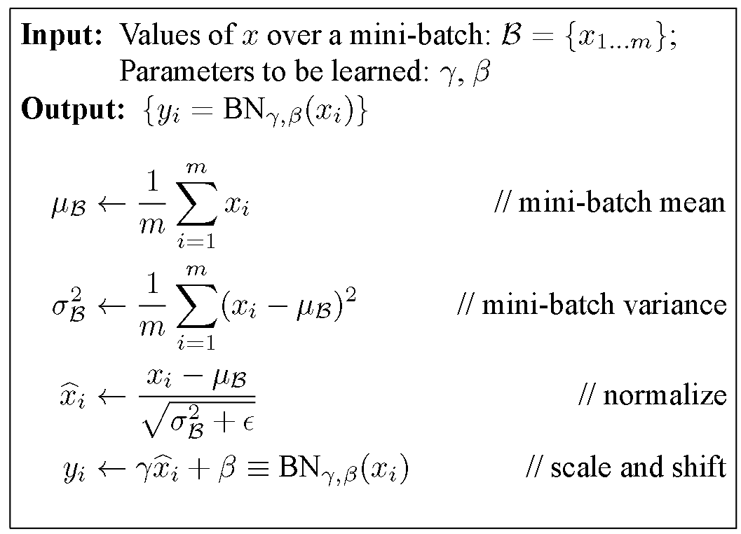
Batch normalization
CONV
xi = i * w + b
By adding batch normalization on all of the convolutional layers in YOLO we get more than 2% improvement in mAP
generalization
Activation function(ReLU)

Slide 10
High resolution classifier
All state-of-the-art detection methods use classifier pre-trained on ImageNet => as feature extraction !
The original YOLO trains the classifier network at 224 × 224 and increases the resolution to 448 for detection
YOLOv2 we first fine tune the classification network at the full 448 × 448 resolution for 10 epochs on ImageNet.
increase of almost 4% mAP

Slide 11
Convolution with anchor boxes
YOLO predicts the coordinates of bounding boxes directly using fully connected layers on top of the convolutional feature extractor

Slide 12
Convolution with anchor boxes
Faster R-CNN predicts bounding boxes using hand-picked priors [15].
Using only convolutional layers the region proposal network (RPN) in
Faster R-CNN predicts offsets and confidences for anchor boxes.
Since the prediction layer is convolutional, the RPN predicts these
offsets at every location in a feature map

Slide 13
RCNN
Selective search
1.Slowly
2.Many Region proposal
3.runing time depends on the
number of proposal
4.Model fixed
1.selective search
2.Trainsfer learning(alex,VGG)
3.svm: classification
4.bounding box:regression
resize
resize
Convs
Convs
SVM
BBOX
SVM
BBOX
Notes:
Selective search (heuristic)= > much bounding box
Pre train Convs extraction feature
SVM
Many proposal over lapping (convs each proposal)
給一張圖 經過ss => resize => conv (ALEX resnet inception) 捲機網路只是抽feature (image net 最後一層拿掉)

Slide 14
fastRCNN
Convs
Different shape
1.overlapping:
Many region convs
=> One convs
2.ROI pooling
ROI Pooling
ROI Pooing
output
Dense
Num_Regions x Num_channels x n x m
softmax
BoxReg
50 | 34 | 34 | 26
32 | 78 | 19 | 73
23 | 34 | 23 | 32
34 | 56 | 56 | 78
(0,1),(3,3)
78 | 73
56 | 78
Runtime dominated by
region proposals(inference)
Notes:
Imporve Convs
may decrease ac
Roi pooling vs maxpooling
Increase resolution
Cut evenly

Slide 15
fasterRCNN
RPN(region proposal net):
Background or foreground ?
Convs
1.RPN(SS)
Resample
Pixel and feature for each bounding box
ROI Pooling
Dense
Convs
softmax
BoxReg
BoxReg
softmax
refine
class
Back ground?
Notes:
Replace selective search
RPN foreground or background

Slide 16
RPN
RPN(region proposal net):
Background or foreground ?
VGG(ZF) channels=512
CONV (kernel =3 ,padding = 1 ,channels= 512)
Vgg or zf
1x1
1x1
Convs
Cls ( 2 (back or foreground) * 9 anchor)
18
Boxreg(4 (coord)* 9 )
36
BoxReg
softmax
Back ground?
Notes:
Select search most background

Slide 17

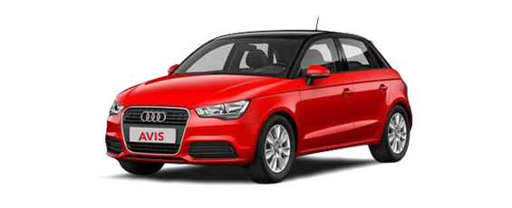
Why anchor box with different scales / aspect ratio

Slide 18
yolov2
label
Target
layer
Input = (4,3,448,448)
Feature
extraction
Predict
layer
Forward
layer
cls
sc
loss
Class
Score
xywh
xywh
output = (4,176,13,13)

Slide 19
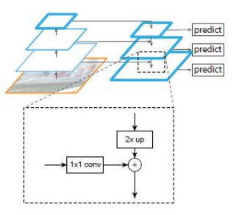
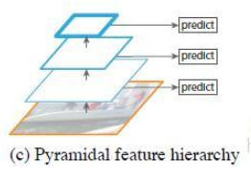
Feature extraction =>yolov3
FPN Base on resnet
SSD

Slide 20
yolov2
label
Target
layer
Input = (4,3,448,448)
Feature
extraction
Predict
layer
Forward
layer
cls
sc
loss
Class
Score
xywh
xywh
output = (4,176,13,13)

Slide 21
Yolo2-predict layer
intput = (4,176,13,13)
Anchor =2
Class=2
Predict
layer
Channels=
(Anchor_scale) * ( class_num + 1 (object_score)+ 4(bbox_coord))
output = (4,14,13,13)

Slide 22
Yolo2-predict layer
anchorbox1
anchorbox2
After feature extraction feature map size
Anchor_scale num=2
Class_num = 2
Class
pred
score
xy
wh
Class
pred
score
xy
wh
intput = (4,176,13,13)
2
1
2
2
2
1
2
2
Channels=
(Anchor_scale) * ( class_num + 1 (object_score)+ 4(bbox_coord))
2 * (2 + 1 + 4 ) = 14
Conv(channels, kernel_size=1, strides=1)
Anchor_scale=[[1,2],[2,1]]
Class_num =2
Predict
layer
output = (4,14,13,13)

Slide 23
yolov2
label
Target
layer
Input = (4,3,448,448)
Feature
extraction
Predict
layer
Forward
layer
cls
sc
loss
Class
Score
xywh
xywh
output = (4,176,13,13)

Slide 24
Yolov2 – forward layer
Anchor scale
Input = (4,14,13,13)
Reshape => (4,13,13,14) => (4,13,13,2,7)
Class_id = argmax(class_pred)
Class_pred=[4,13,13,2,2]
Score=[4,13,13,2,1]
Xywh=[4,13,13,2,4]
Output=(4,13,13,2,6)
[cid,score,x,y,w,h]
Class_pred
score
xy
wh
2
1
2
2
sigmoid
exp
*
score
xy
Anchor
norm
wh

Slide 25
Forward layer _ class_pred
4,16,16,2,2
Class_pred=[4,16,16,2,2]
Class_id = argmax(class_pred)
Class_pred
argamx
Class_id
4,16,16,2,1

Slide 26
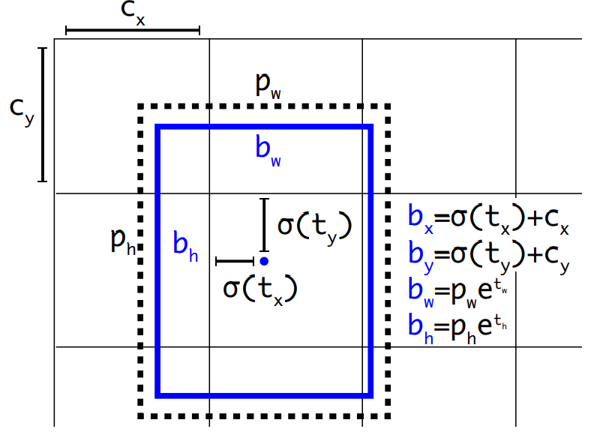
Transform
0~1
/w
/h
/w
/h
Non negative
Anchor scaling

Slide 27
Transform center
xy
xy
2
sigmoid
sigmod
xy
xy(0~1)
norm
Axis_x = 0~9
Axis_y = 0~9
0.2,0.3
0.3,0.1
0.6,0.2
0,0
3,1
6,2
+
0.1,0.3
0.4,0.4
0.7,0.5
1,3
4,4
7,5
/(3,3)
0.2,0.6
0.5,0.7
0.8,0.8
2,6
5,7
8,8

Slide 28
Transform WH
wh
wh
2
*
exp
exp
Anchor
(1,2)
(2,1)
Wh
(non-neg)
/(w,h)
Anchor
*
norm
wh

Slide 29
yolov2
label
Target
layer
Input = (4,3,448,448)
Feature
extraction
Predict
layer
Forward
layer
cls
sc
loss
Class
Score
xywh
xywh
output = (4,176,13,13)

Slide 30
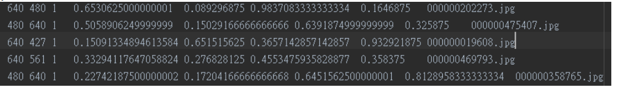
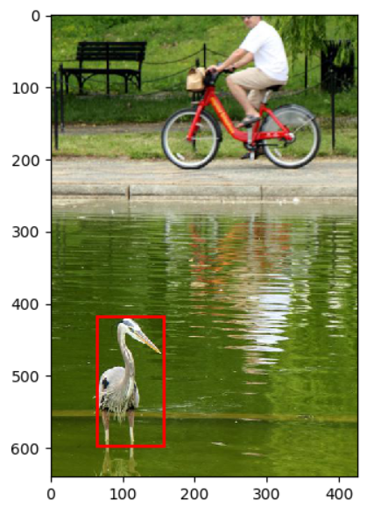
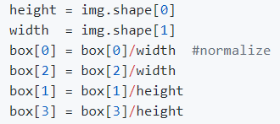
How to labeling

Slide 31
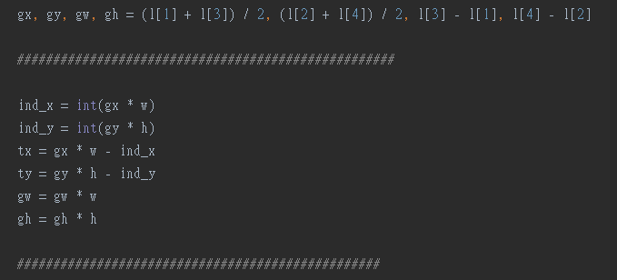
Compute gx,gy,gw,gh

Slide 32

Matching strategy
For each ground truth box we are selecting from default boxes that vary over location, aspect ratio, and scale.
We begin by matching each ground truth box to the default box with the best jaccard overlap
we then match default boxes to any ground truth with jaccard overlap higher than a threshold (0.5). allowing the network to predict high scores for multiple overlapping default boxes rather than requiring it to pick only the one with maximum overlap
ssd

Slide 33
Hard negative mining -ssd
most of the default boxes are negatives, especially when the number of possible default boxes is large
we sort them using the highest confidence loss for each default box and pick the top ones so that the ratio between the negatives and positives is at most 3:1

Slide 34
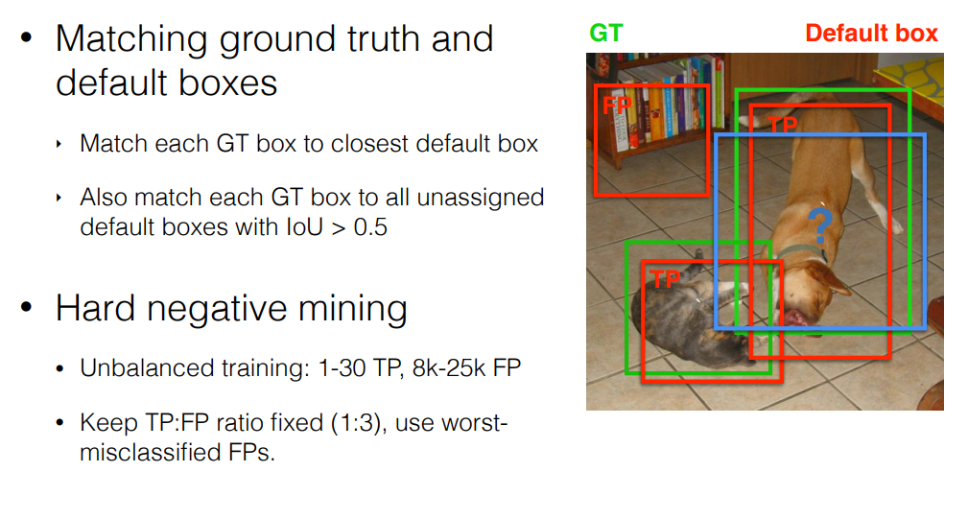
Hard negative mining -ssd

Slide 35
Intersect
Find the best match use width,height only assuming centers are identical
Intersect = min(bbox_w, anchor_w) *min(bbox_h,anchor_h)
Ovlps = intersect / (bbox_w * bbox_h + anchor_w*anchor_h – intersect)
anchor
Best_match = argmax(ovlps)
bbox

Slide 36
Target layer output
Twh = Log ( g / anchor[best_match]
Prediction = Xywh=[4,13,13,2,4]
Targetbox [batch, ind_x, ind_y, bsm] = txywh
Targetcls [batch, ind_x, ind_y, bsm] = label_cls

Slide 37
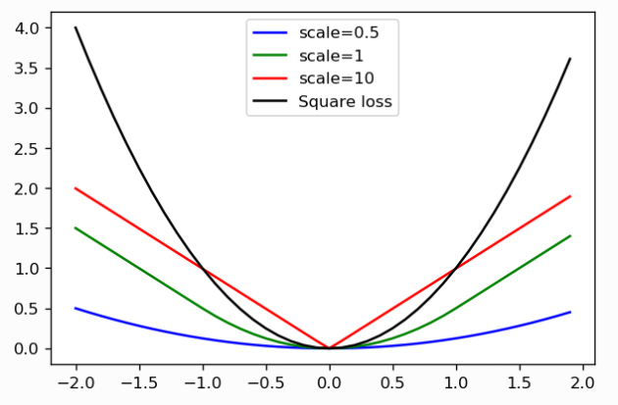
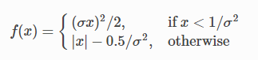
loss
Class loss = softmaxCrossEntropy * 1
Bbox loss = softl1 loss * 5
L2 sensitive if error bigger => error penalty much higher
Use L1 error => linear not square increase

Slide 38
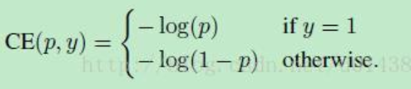
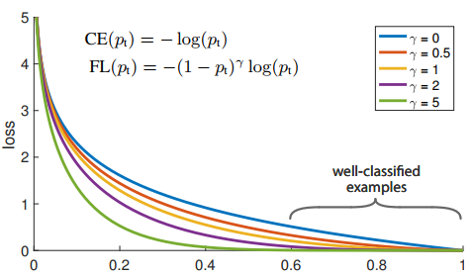
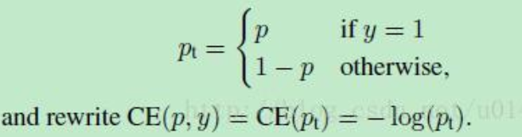
Focal loss FOCAL LOSS FOR DENSE OBJECT DETECTION iccv2017 BEST PAPER
PREDICT passable
Pt 0~1
Notes:
Focal Loss，大大降低那些負樣本的Loss Contribution，
預測還行 LOSS 低
One-Stage want prdict classification localization on Extracted Feature Map
One image generate 100000（Anchors），
Positive samples less
Training sampling imbalance
容易被歸類的負樣本背景區域（well-classified negative samples）
即使這些well-classfied samples每一個所貢獻的loss很小 但很多還是佔了全部loss的很大部分
需要被分類的positive samples貢獻的loss不明顯，梯度傳播就不夠準確。
想成一個loss函數，由於noise太多，minima不明顯

Slide 39
Focal loss
We tried using focal loss. It dropped our mAP about 2 points. YOLOv3 may already be robust to the problem .

Slide 40
Yolov2 inference
Input = (4,3,448,448)
Feature
extraction
Predict
layer
Forward
layer
cls
sc
NMS
xywh
output = (4,176,13,13)

Slide 41
non-maximum suppression
0.9
0.8
0.6

Slide 42
non-maximum suppression
0.9
if
IOU>0.5
0.8
=0

Slide 43
non-maximum suppression
0.9
if
IOU>0.5
=0
0.6

Slide 44
non-maximum suppression
0.9
0.8
0

Slide 45
Dimension clusters
encounter two issues with anchor boxes when using them with YOLO
first is that the box dimensions are hand picked
we run k-means clustering on the training set bounding boxes to automatically find good priors.
Notes:
The network can learn to adjust the boxes appropriately but if we pick better priors for
the network to start with we can make it easier for the network to learn to predict good detections.

Slide 46
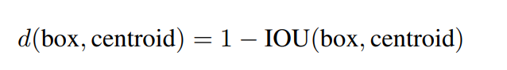
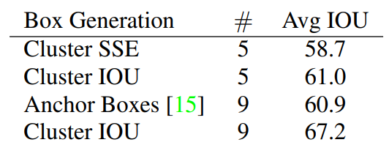
Dimension clusters
Clustering gives much better
results than using hand-picked priors.

Slide 47
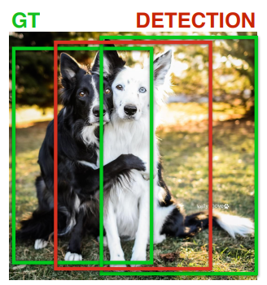
Anchor much is better

Slide 48
Fine grained features
it may benefit from finer grained features for localizing smaller objects. Faster R-CNN and SSD both run their proposal networks at various feature maps in the network to get a range of resolutions
Faster R-CNN => RPN, resnet
SSD => multiscale prediction

Slide 49
passthrough layer
The passthrough layer concatenates the higher resolution features with the low resolution features
adding a passthrough layer that brings features from an earlier layer at 26 × 26 resolution.
26x26x256 => concat( 13x13x1024 , 13x13x1024,dim=3)
1% performance increase

Slide 50
Multi-scale training
We want YOLOv2 to be robust to running on images of different sizes so we train this into the model.
This regime forces the network to learn to predict well across a variety of input dimensions. This means the same network can predict detections at different resolutions

Slide 51
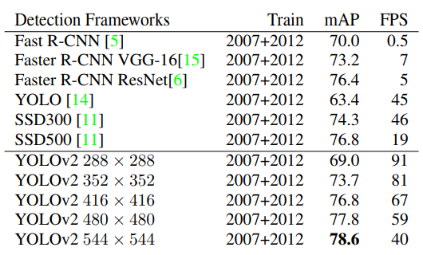
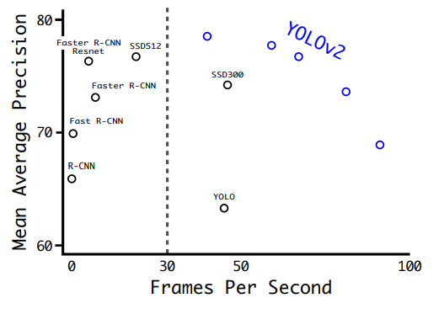
Accuracy and speed
At 288 × 288 it runs at more than 90 FPS with mAP almost as good as Fast R-CNN.
At high resolution YOLOv2 is a state-of-the-art detector with 78.6 mAP on VOC 2007 while still operating above real-time speeds

Slide 52
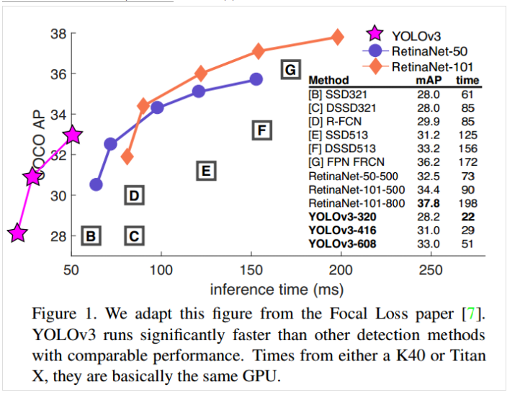
Yolo v3

Slide 53
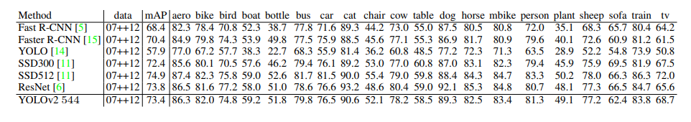
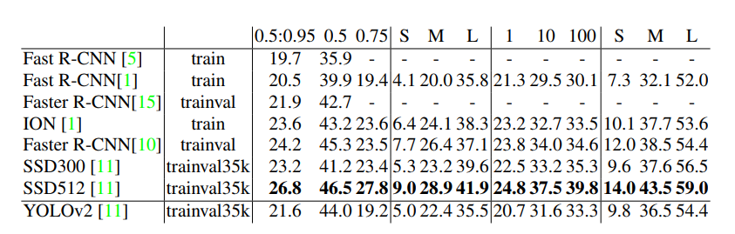
Further Experiments.
IOU,AP
Area,AP
Det,recall
area,recall

Slide 54
SSD
Classic model (VGG residual)
convs
32,32,num_anchors * (num_classes + 1 )
1.classification = object_class+1(background)
2.muti scale detection
Output channels =
num_anchors * (num_classes + 1 )
1,64,32,32
4096 defalutbox
softmax
BoxReg
Ouput channel =
num_anchor box * 4
Default box
Class = 2
…
4160,4
32,32, num_anchor box * 4
Convs
Pred class
…
1,128,4,4
64 defalutbox
softmax
4160,3
BoxReg
Gt class
1,3
Output default box = (4160,4)
Output class = (4160,3) Output bbox = (16640)
Bouning box
(1,4)

Slide 55
Faster
VGG-16 as the base feature extractor [17]. VGG-16 is a powerful, accurate classification network but it is needlessly complex.
uses a custom network based on the Googlenet architecture

Slide 56
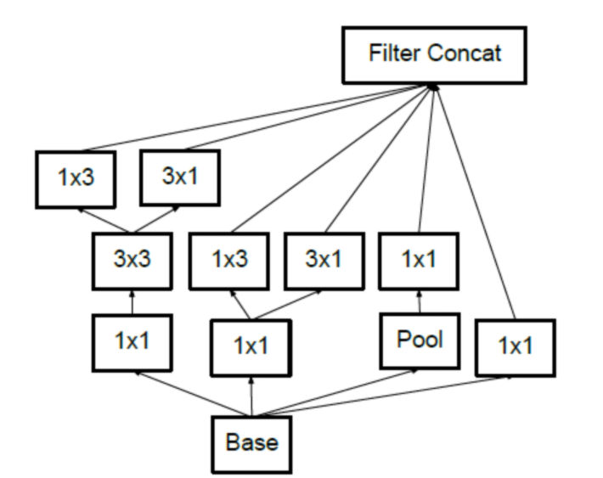
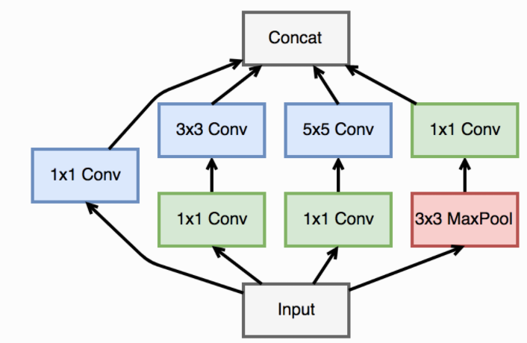
Google net

Slide 57
Why useful
First: use 1x1 conv:
1 × 1 filters to compress the feature representation between 3 × 3 convolutions
Context about channel wise
1x1 conv can increase / decrease dimension, decrease parameters

Slide 58
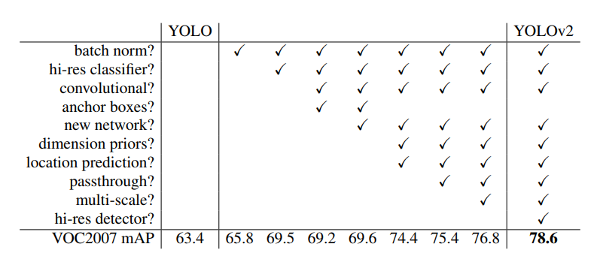
The path from YOLO to YOLOv2

Slide 59
Training for detection
the number of outputs we need for detection. For VOC we predict 5 boxes with 5 coordinates each and 20 classes per box so 125 filters.
5* (5 + 20 ) = 125

Slide 60
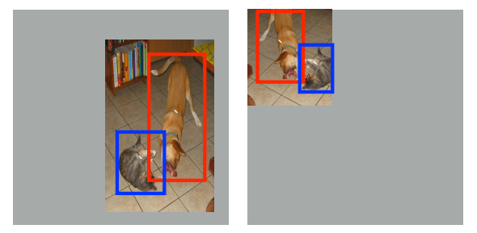
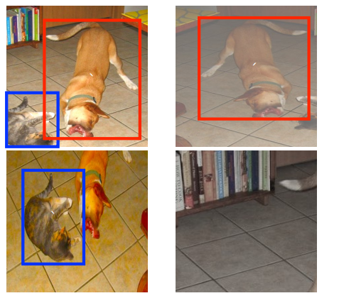
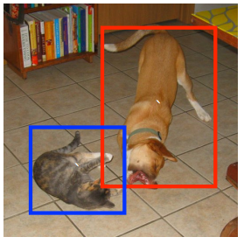
Data augmentation
Data
Random expansion creates more small
training examples
each sampled patch is resized to fixed size and is horizontally flipped
with probability of 0.5, in addition to applying some photo-metric
distortions similar to those described

Slide 61
Stronger
jointly training on classification and detection data
training we mix images from both detection and classification datasets .
When our network sees an image labelled for detection we can backpropagate based on the full YOLOv2 loss function.
When it sees a classification image we only backpropagate loss from the classification specific parts of the architecture.

Slide 62
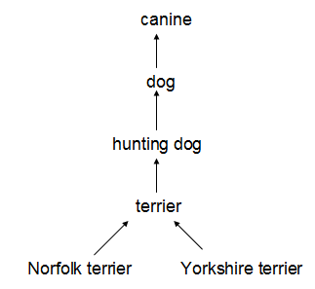
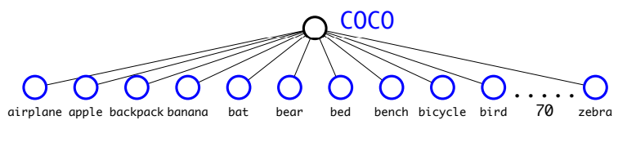
Hierarchical classfication
Most approaches to classification assume a flat structure to the labels however for combining datasets, structure is exactly what we need.
WordNet is structured as a directed graph, not a tree, because language is complex.

Slide 63
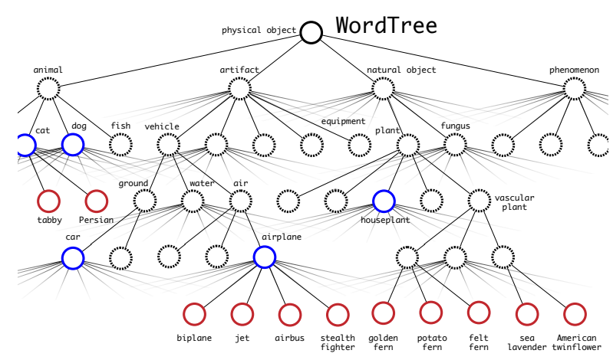
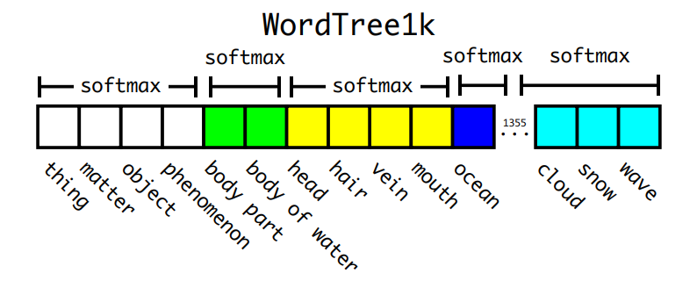
WordTree
To perform classification with WordTree we predict conditional probabilities at every node for the probability of each hyponym of that synset given that synset
Notes:
hierachical

Slide 64
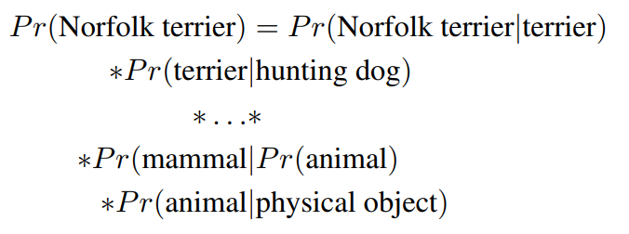
Prediction on wordtree
To perform classification with WordTree we predict conditional probabilities at every node for the probability of each hyponym of that synset given that synset
softmax

Slide 65
Joint classification and detection
Total 9418 class ( 9K imageNet + 80 COCO)
Last layer 17 x 17 x 3 x( 9418 + 4 + 1 )
Internal node => softmax
Above threshold (0.5) and deepest node

Slide 66
Joint classification and detection
it sees a classification image we only
backpropagate classification loss.
To do this we simply find the bounding box that predicts the highest probability for that class
assume that the predicted box overlaps what would be the ground truth label by at least .3 IOU and we backpropagate objectness loss based on this assumption
when our network sees a detection image we backpropagate loss as normal.
For classification loss, we only backpropagate loss at or above the corresponding level of the label.

Slide 67
conclusion
YOLOv2 is state-of-the-art and faster than other detection systems across a variety of detection datasets.
YOLO9000 is a real-time framework for detection more than 9000 object categories by jointly optimizing detection and classification.
Dataset combination using hierarchical classification would be useful in the classification and segmentation domains.
For future work we hope to use similar techniques for weakly supervised image segmentation

Slide 68
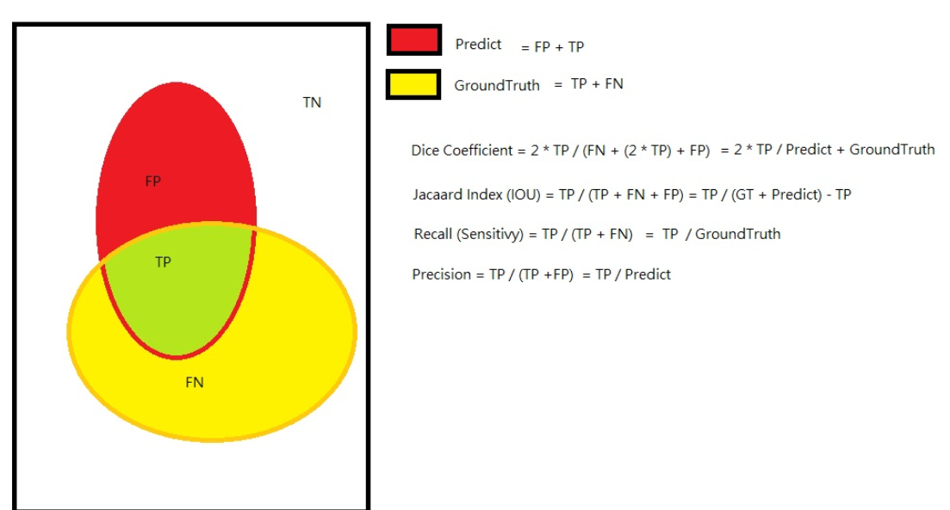
appendix
Notes:
我們認為當預測的bounding box和ground truth的IoU大於某個閾值（如取為0.5时 > 0.5，時，認為是一個True Positive。如果小于这个阈值，如果小於這個閾值，就是一個False Positive。

